Slide 1

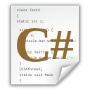


C# Part II – Course Intro
http://csharpfundamentals.telerik.com
Course Program, Evaluation and Exams
Svetlin Nakov
Technical Trainer
www.nakov.com
Telerik Software Academy
academy.telerik.com

Slide 2
Презентацията не е актуална!
Опитайте по-късно.

Slide 3

Table of Contents
What Happens Now?
The Upcoming Program
The Changes in the Course
C# Game
Lecture Attendance
New Bonuses
Introduction to C# in English + PC Magazine
Best Students from Fundamentals of C# Part I
Some Awards to Give

Slide 4

C# Fundamentals – Part II
Coming To The Next Module

Slide 5

What's Coming Next?
Pretty much the same
Lectures two times a week
Intermediate exam after month and a half
The intermediate exam?
5 problems
6 hours

Slide 6
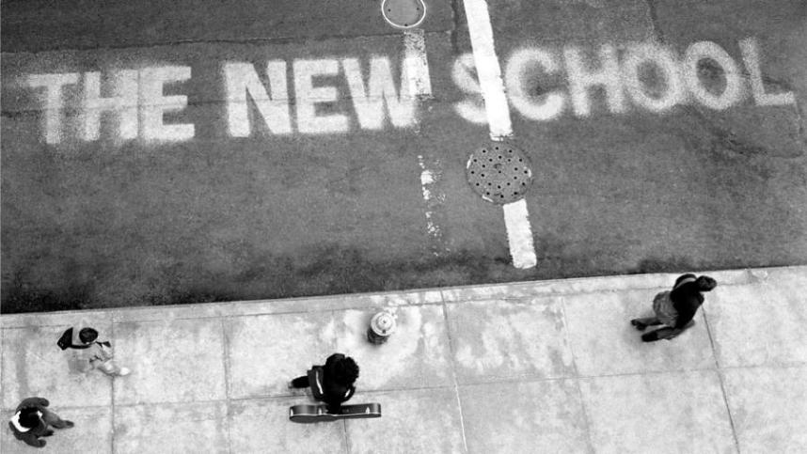
The New Program
What Will We Cover Next?

Slide 7
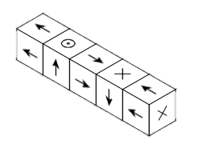

The C# II Course Program
Arrays
Creating and usage
Multidimensional Arrays
Matrices, cubes etc.
Numeral Systems
Binary, Octal, Decimal, Hexadecimal
Types representation in memory
Methods
Return type, arguments, overloading

Slide 8
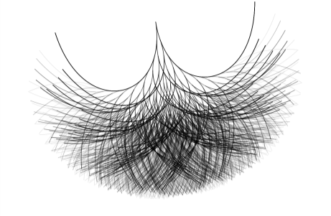

The C# II Course Program (2)
Recursion
Lots of examples
Creating and Using Objects
What are object?
How to benefit from them?
Exception handling
What are exception?
Catching, throwing exceptions

Slide 9



The C# II Course Program (3)
Strings and text processing
Important methods
StringBuilder
Defining Classes
Constructors, class members
Properties, fields and methods
Text files
Reading and writing text files
Intermediate Exam

Slide 10


Changes to the Course

Slide 11

C# Game
You need to submit your activity once per day
All the things you did that day
You can find it here: http://bit.ly/CSharpGame

Slide 12
Lecture Attendance
Starting from the C# Fundamentals Part II
The attendance is required
Students attended less than 70% will be fired
Attendance will be registered at every lecture
As well as coming behind the schedule
Attendance will be part of your total score

Slide 13



Evaluation
Thank God there are Bonuses

Slide 14
Second Exam Evaluation
Exam – 80%
Homework + C# Game – 20%
Forums activity – bonus up to 10%
Bug submissions in the Book – bonus 10%
Helping the other students – bonus up to 10%
Translation of some chapter of the Book
Bonus up to 10%
Application with cover letter
PC Magazine Contest – bonus up to 5%

Slide 15

Champions of the First Part
The Usual Telerik Academy Champions

Slide 16


First Student With Maximal Exam Score
Kristian Doichinov Tashkov
First exam day
Anton Kirilov Sotirov
Second exam day

Slide 17

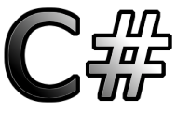
Most Active Student in the Forum
Stamo Hristov Gochev

Slide 18
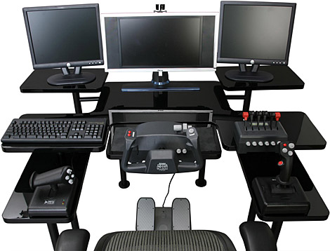

Most Posts in the C# Game
Nadezhda Nikolova Petrova

Slide 19


Best Software Engineering Essay Award
Stefan Stefanov Baychev

Slide 20


Most Bugs Found In The Book
Vasya Georgieva Stankova

Slide 21



Most Helpful Student
Nikolay Evgeniev Demirev

Slide 22
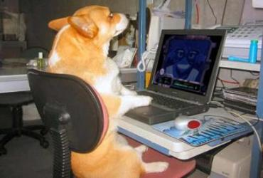
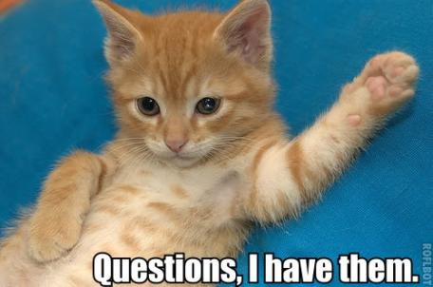

C# Fundamentals – Part II Introduction
http://academy.telerik.com

Slide 23

Introduce Yourself!
Now introduce yourself to the others
Who are you, what is your background, why you came at Telerik Software Academy, …?

Slide 24




Free Trainings @ Telerik Academy
“C# Programming @ Telerik Academy
csharpfundamentals.telerik.com
Telerik Software Academy
academy.telerik.com
Telerik Academy @ Facebook
facebook.com/TelerikAcademy
Telerik Software Academy Forums
forums.academy.telerik.com

